Slide 1

Welcome!
Girl Scouts - NC Coastal Pines
Parent Intro and FAQ
With - Debbie Todd, Membership Director, GSNCCP

Slide 2
Introduction to
Girl Scouts

Slide 3
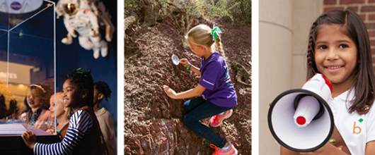
Why choose Girl Scouts?

Slide 4

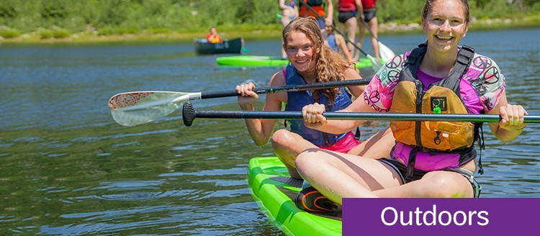
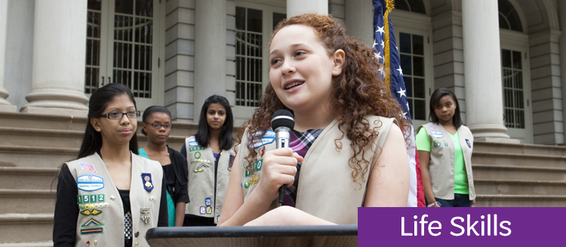
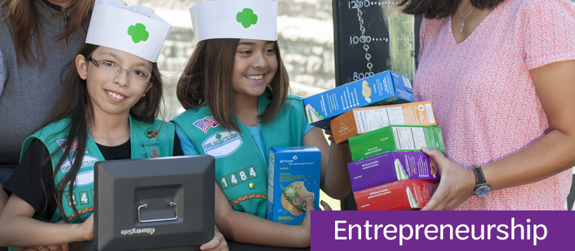
4 Pillars of Girl Scouts

Slide 5
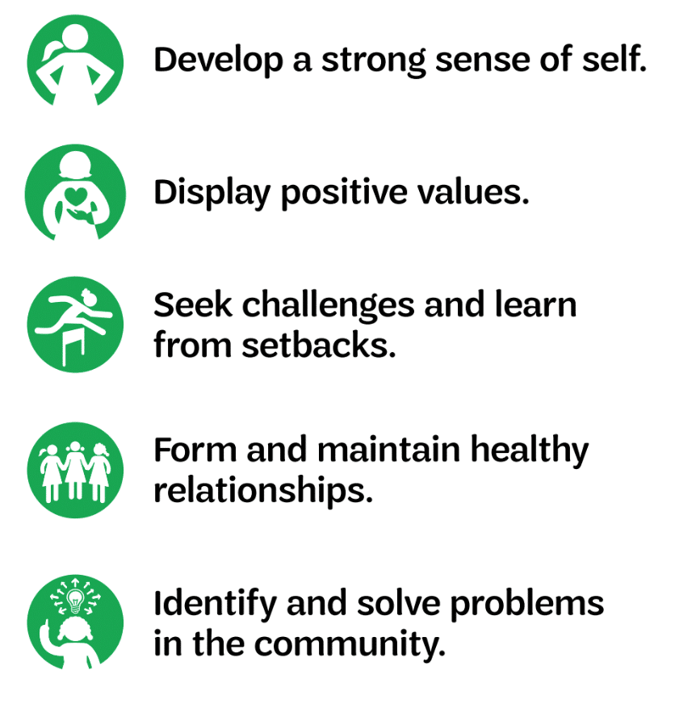

5 ways Girl Scouts thrive

Slide 6

FUN with PURPOSE

Slide 7
Frequently
Asked
Questions

Slide 8
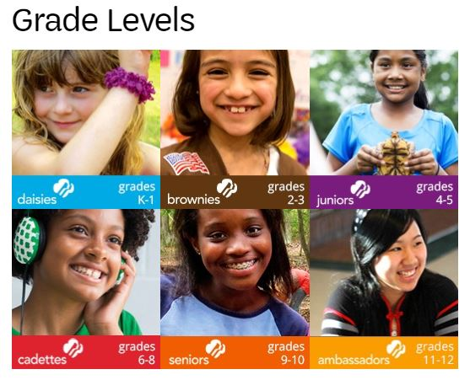
What level will my daughter be when she joins?
Learn more about the activities of these grade levels on our website:
https://www.nccoastalpines.org/en/about-girl-scouts/our-program/grade-levels.html

Slide 9
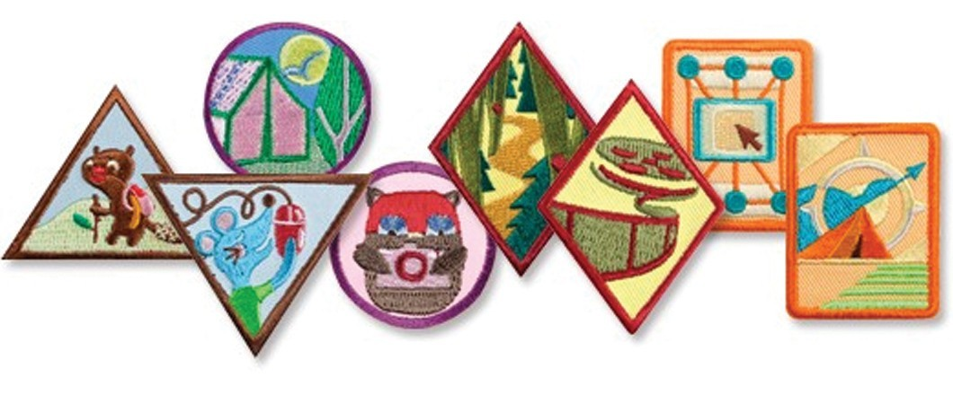
How many badges will she complete to move to the next level?

Slide 10

What is the time commitment?

Slide 11
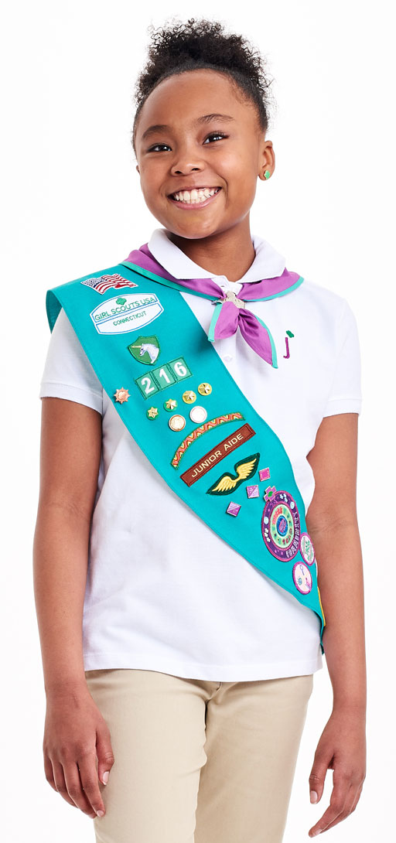
What is the Girl Scout uniform, and will she need it?
Uniform – tunic, sash or vest with insignia tab and membership pin
Typically worn over clothes at troop meetings or troop events
Can be purchased online - https://www.girlscoutshop.com/NORTH-CAROLINA-COASTAL-PINES-COUNCIL
Additional Questions? Call 1-800-284-4475

Slide 12

How do we join?
Visit www.nccoastalpines.org
Click- JOIN NOW
Provide contact information
Search for troops in your area
Register

Slide 13
Thanks for joining us!
Excited to join in on the fun?
www.nccoastalpines.org
customercareteam@nccoastalpines.org
1-800-284-4475

